Slide 1

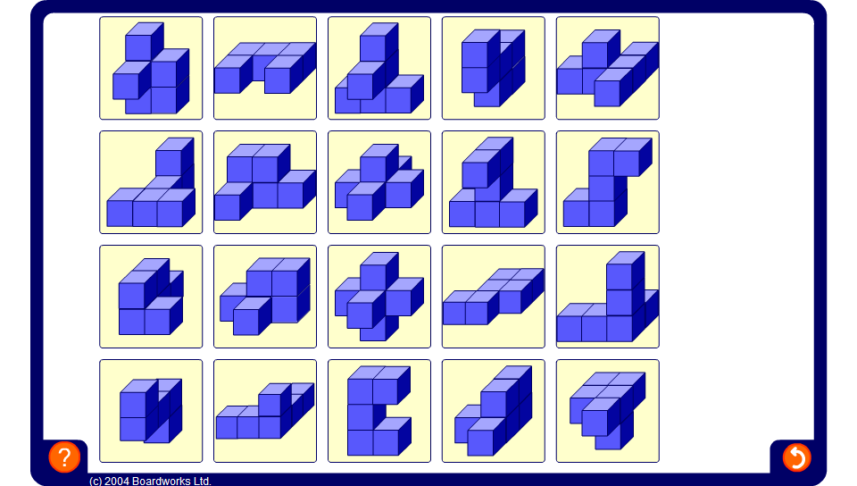


Equivalent shape match
Notes:
For each shape, challenge pupils to find the same shape shown in a different orientation.

